Slide 1
OSPF

Slide 2
Objectives
Describe the background and basic features of OSPF
Identify and apply the basic OSPF configuration commands
Describe, modify and calculate the metric used by OSPF
Describe the Designated Router/Backup Designated Router (DR/BDR) election process in multiaccess networks
Describe the uses of additional configuration commands in OSPF

Slide 3
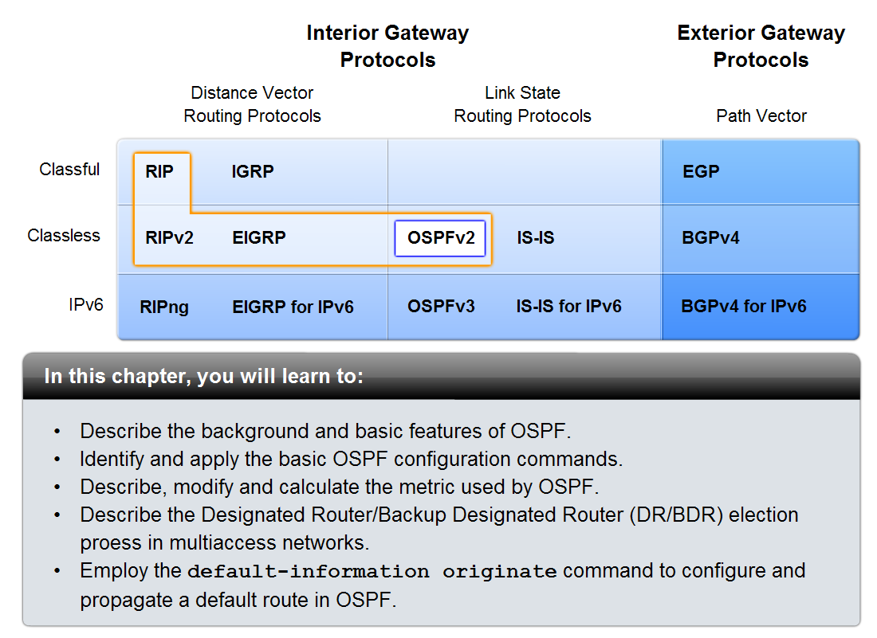
Introduction

Slide 4
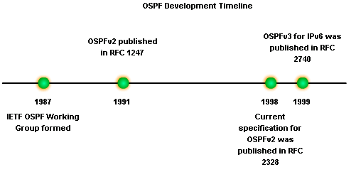
Introduction to OSPF
Background of OSPF
Began in 1987
1989 OSPFv1 released in RFC 1131
This version was experimental & never deployed
1991 OSPFv2 released in RFC 1247
1998 OSPFv2 updated in RFC 2328
1999 OSPFv3 published in RFC 2740

Slide 5
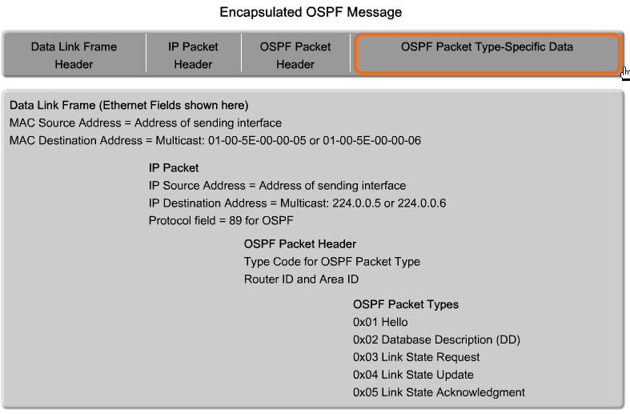
Introduction to OSPF
OSPF Message Encapsulation
OSPF packet type
  There exist 5 types
OSPF packet header
  Contains - Router ID and area ID and Type code for OSPF packet type
IP packet header
Contains - Source IP address, Destination IP address, & Protocol field set to 89

Slide 6
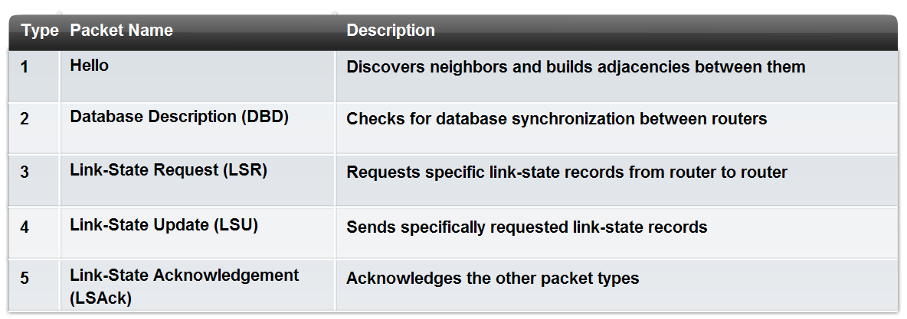
Introduction to OSPF
OSPF Packet Types

Slide 7
Introduction to OSPF
Hello Protocol
OSPF Hello Packet
  Purpose of Hello Packet
    Discover OSPF neighbors & establish adjacencies
    Advertise guidelines on which routers must agree to become neighbors
    Used by multi-access networks to elect a Designated Router and a Backup Designated Router

Slide 8
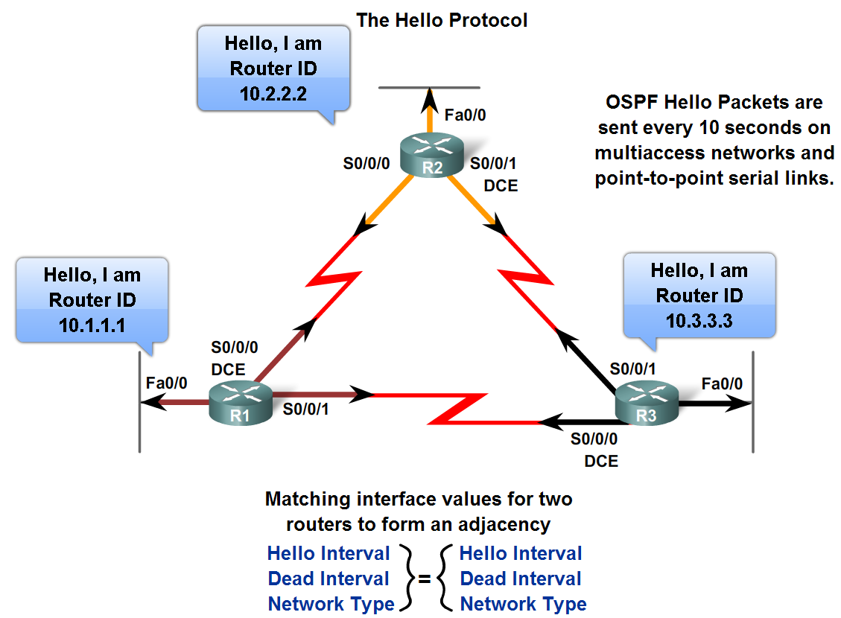
Introduction to OSPF
Hello Packets continued
  Contents of a Hello Packet
  router ID of transmitting router
OSPF Hello Intervals
  Usually multicast (224.0.0.5)
  Sent every 30 seconds for NBMA segments and every 10 on multi-access segments
OSPF Dead Intervals
  This is the time that must transpire
  before the neighbor is considered
  down
  Default time is 4 times
  the hello interval

Slide 9
Introduction to OSPF
Hello protocol packets contain information that is used in electing
  -Designated Router (DR)
  DR is responsible for updating all other OSPF routers
  -Backup Designated Router (BDR)
  This router takes over DR’s responsibilities if DR fails

Slide 10
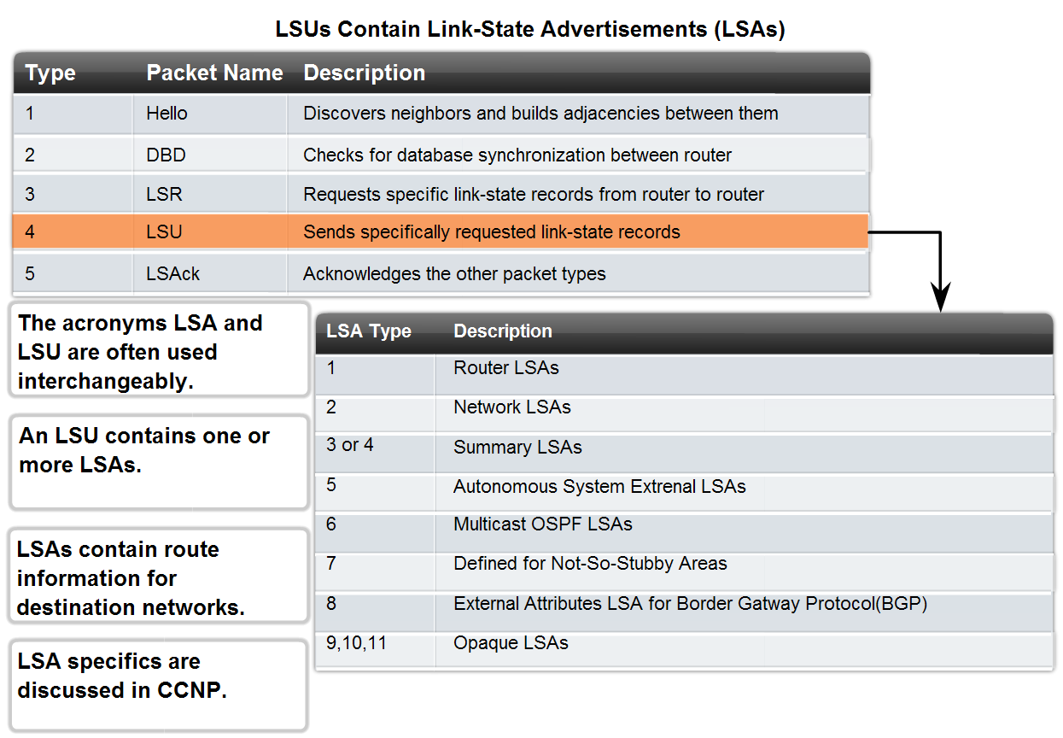
Introduction to OSPF
OSPF Link-state Updates
Purpose of a Link State Update (LSU)
  Used to deliver link state advertisements
Purpose of a Link State Advertisement (LSA)
  Contains information about neighbors & path costs

Slide 11
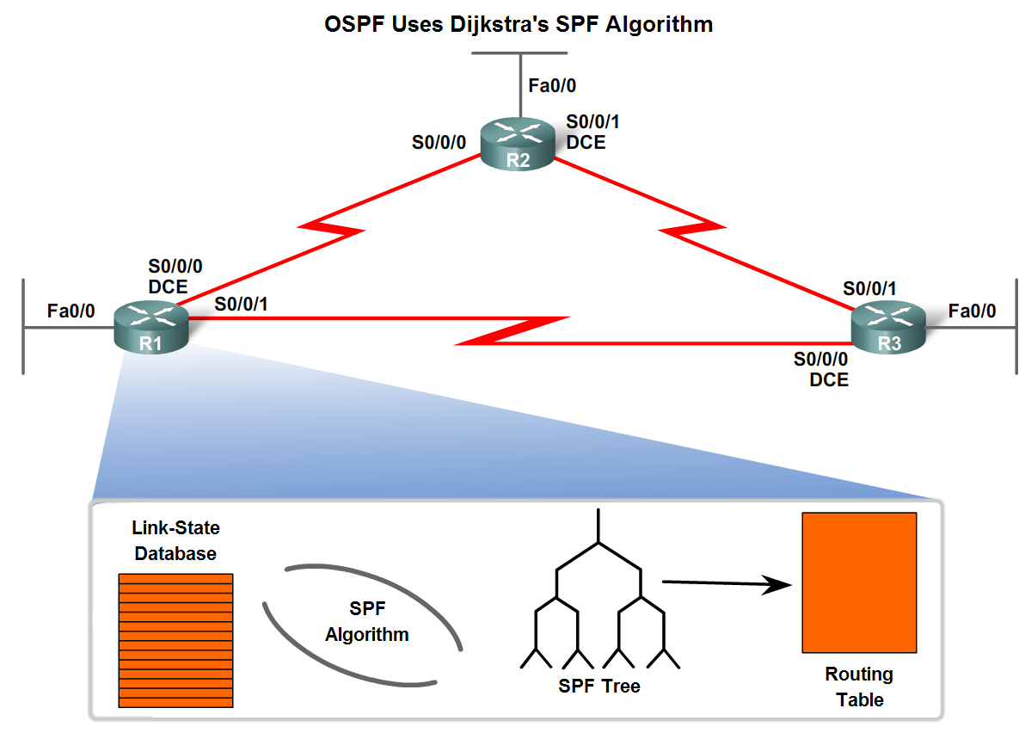
Introduction to OSPF
OSPF Algorithm
OSPF routers build & maintain link-state database containing LSA received from other routers
  Information found in database is utilized upon execution of Dijkstra SPF algorithm
  SPF algorithm used to create SPF tree
  SPF tree used to populate routing table

Slide 12
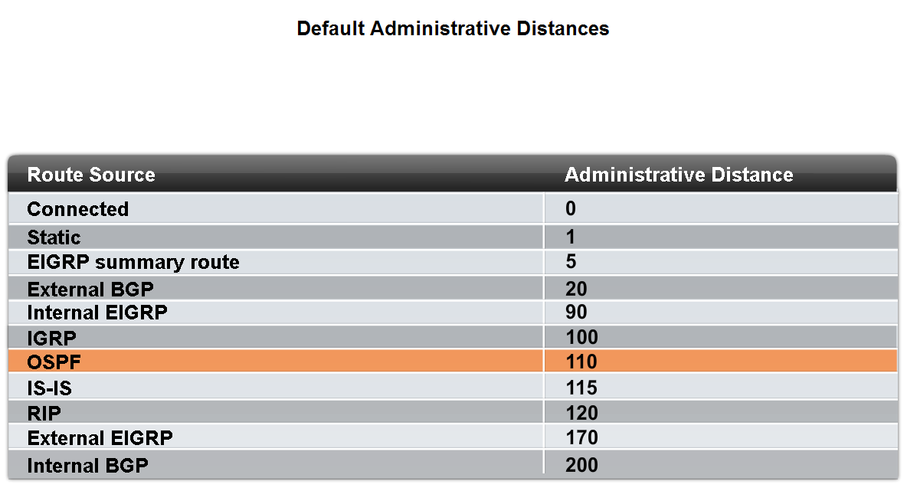
Introduction to OSPF
Administrative Distance
Default Administrative Distance for OSPF is 110

Slide 13
Introduction to OSPF
OSPF Authentication
  Purpose is to encrypt & authenticate routing information
  This is an interface specific configuration
  Routers will only accept routing information from other routers that have been configured with the same password or authentication information

Slide 14
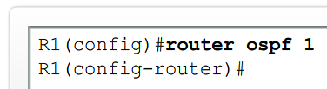


Basic OSPF Configuration
The router ospf command
To enable OSPF on a router use the following command
  R1(config)#router ospf process-id
  Process id
  A locally significant number between 1 and 65535
  -this means it does not have to match other OSPF routers

Slide 15
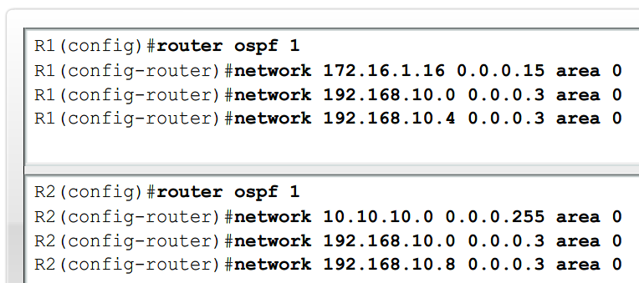
Basic OSPF Configuration
OSPF network command
  -Requires entering: network address
  wildcard mask - the inverse of the subnet mask
  area-id - area-id refers to the OSPF area. OSPF area is a group of routers that share link state information
  -Example: Router(config-router)#network network-address wildcard-ask area area-id

Slide 16
Basic OSPF Configuration
Router ID
  This is an IP address used to identify a router
  3 criteria for deriving the router ID
    Use IP address configured with OSPF router-id command
      -Takes precedence over loopback and physical interface addresses
    If router-id command not used then router chooses highest IP address of any loopback interfaces
    If no loopback interfaces are configured then the highest IP address on any active interface is used

Slide 17
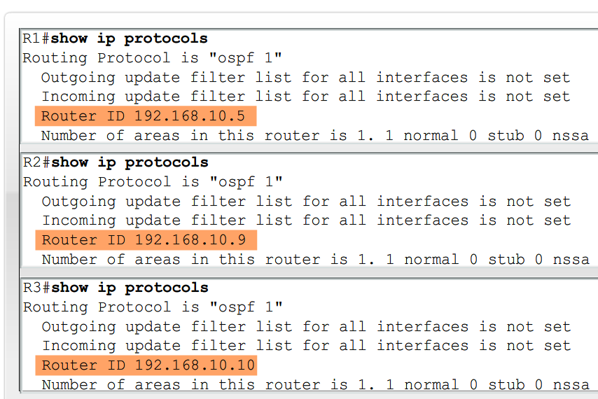
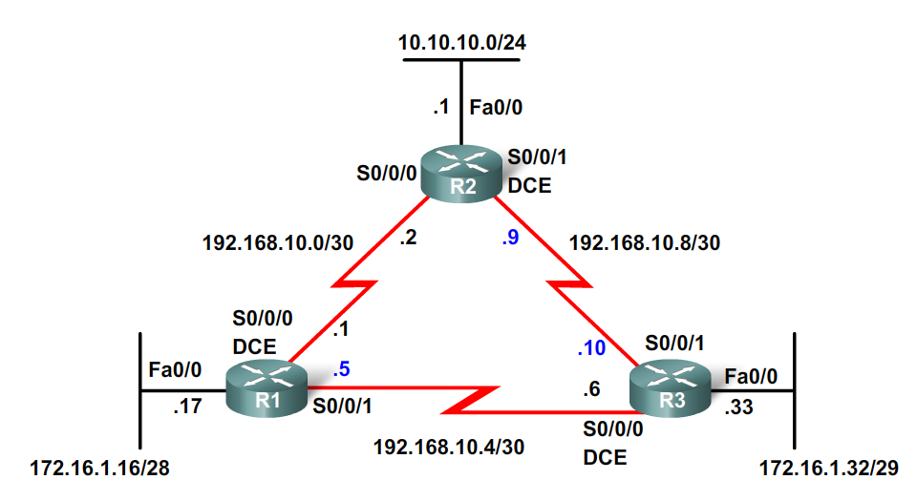
Basic OSPF Configuration
OSPF Router ID
Commands used to verify current router ID
  Show ip protocols
  Show ip ospf
  Show ip ospf interface

Slide 18

Basic OSPF Configuration
OSPF Router ID
Router ID & Loopback addresses
  -Highest loopback address will be used as router ID if router-id command isn’t used
  -Advantage of using loopback address
  the loopback interface cannot fail → OSPF stability
The OSPF router-id command
  Introduced in IOS 12.0
  Command syntax
    Router(config)#router ospf process-id
    Router(config-router)#router-id ip-address
Modifying the Router ID
  After that you should use the command Router#clear ip ospf process

Slide 19
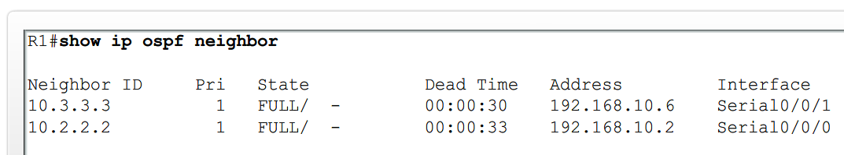
Basic OSPF Configuration
Verifying OSPF
Use the show ip ospf command to verify & troubleshoot OSPF networks
  Command will display the following:
  Neighbor adjacency
  -No adjacency indicated by -
        Neighboring router’s Router ID is not displayed
        A state of full is not displayed
  -Consequence of no adjacency-
        No link state information exchanged
        Inaccurate SPF trees & routing tables

Slide 20
Basic OSPF Configuration
Verifying OSPF - Additional Commands
Command | Description
Show ip protocols | Displays OSPF process ID, router ID, networks router is advertising & administrative distance
Show ip ospf | Displays OSPF process ID, router ID, OSPF area information & the last time SPF algorithm calculated
Show ip ospf interface | Displays hello interval and dead interval

Slide 21
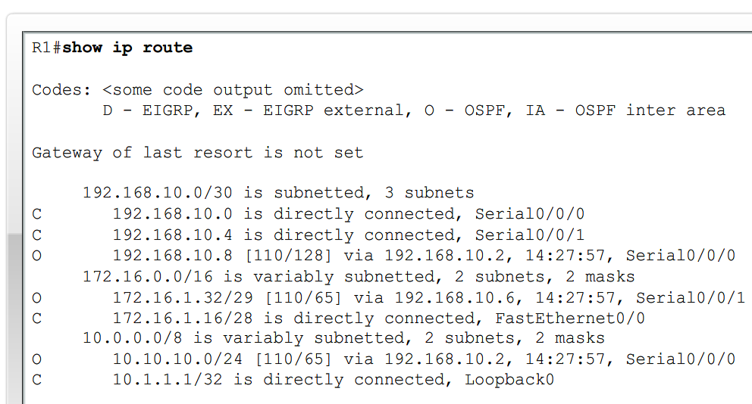
Basic OSPF Configuration
Examining the routing table
Use the show ip route command to display the routing table
  -An “O’ at the beginning of a route indicates that the router source is OSPF
  -Note OSPF does not automatically summarize at major network boundaries

Slide 22
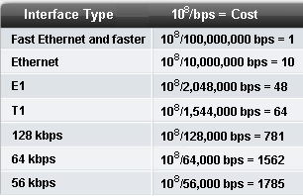
OSPF Metric
OSPF uses cost as the metric for determining the best route
  -The best route will have the lowest cost
  -Cost is based on bandwidth of an interface
    Cost is calculated using the formula
  10⁸ / bandwidth
  -Reference bandwidth
    defaults to 100Mbps
    can be modified using
      Router(config-router)#auto-cost reference-bandwidth

Slide 23
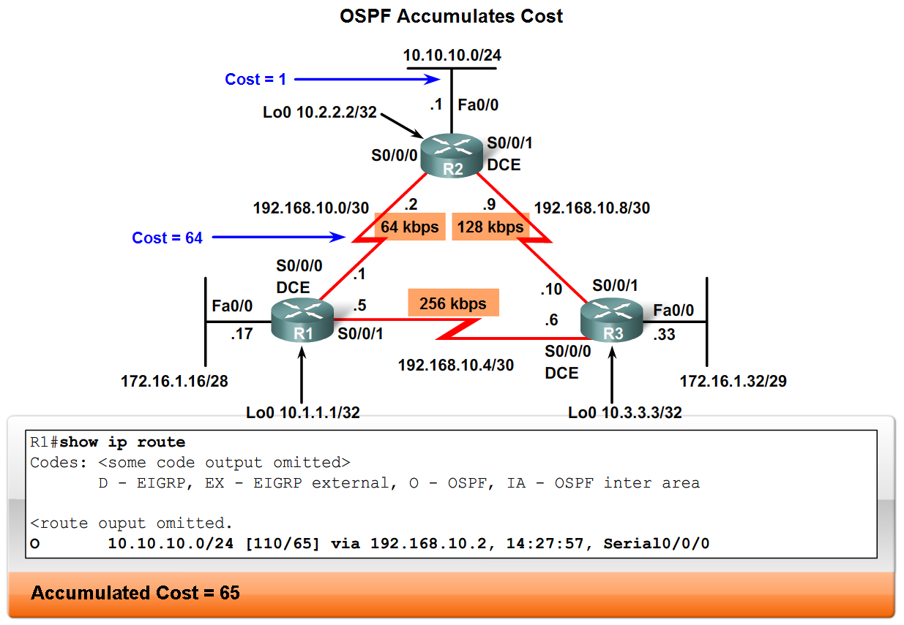
OSPF Metric
Cost of an OSPF route
  Is the accumulated value from one router to the next

Slide 24
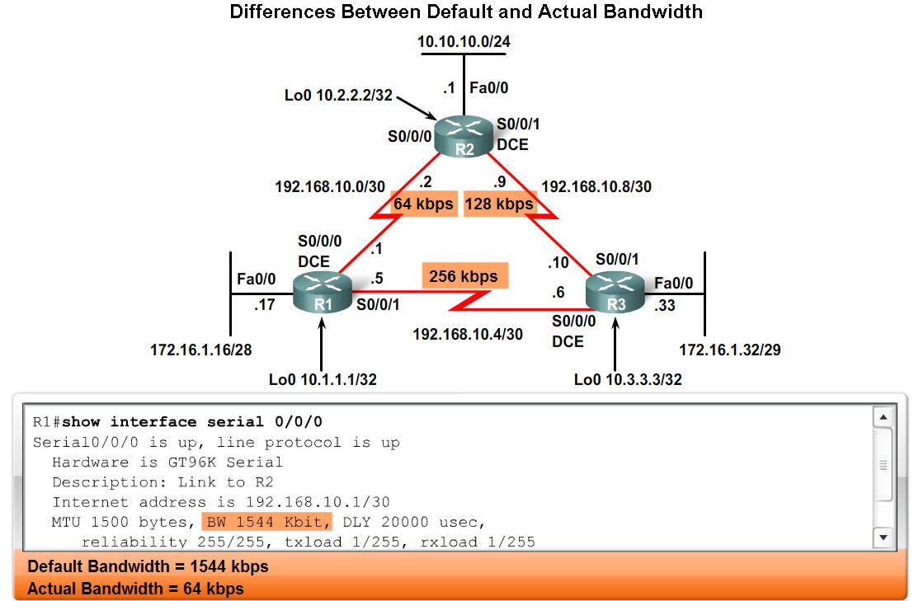
OSPF Metric
Usually the actual speed of a link is different than the default bandwidth
  This makes it imperative that the bandwidth value reflects link’s actual speed
    Reason: so routing table has best path information
The show interface command will display interface’s bandwidth
  -Most serial link default to 1.544Mbps

Slide 25
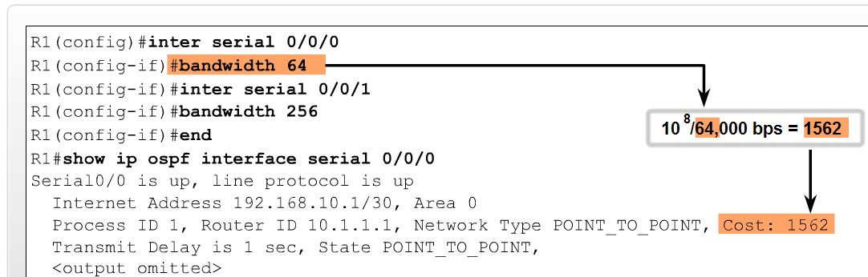
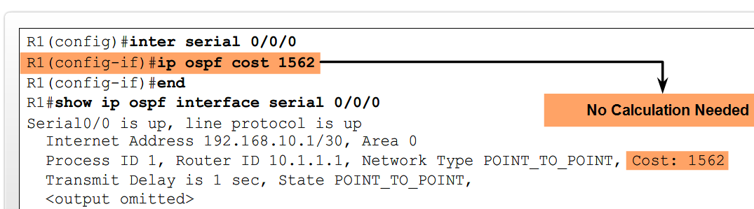
Basic OSPF Configuration
Modifying the Cost of a link
Both sides of a serial link should be configured with the same bandwidth
  Commands used to modify bandwidth value
    Bandwidth command
      Example: Router(config-if)#bandwidthbandwidth-kbps
    ip ospf cost command – allows you to directly specify interface cost
      -Example:R1(config)#interface serial 0/0/0
      R1(config-if)#ip ospf cost 1562

Slide 26
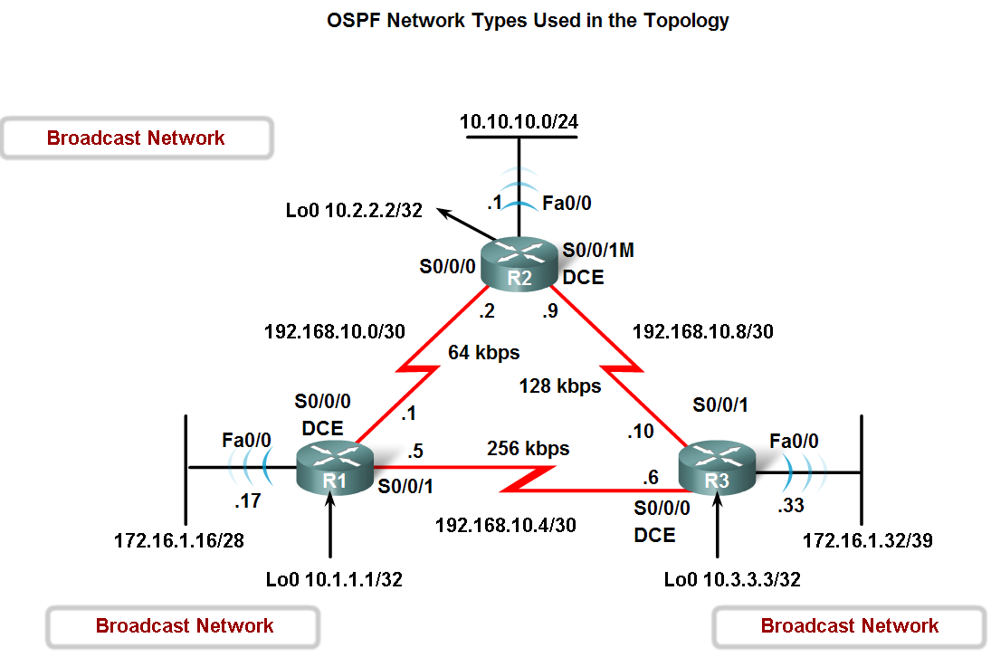
OSPF and Multiaccess Networks
Challenges in Multiaccess Networks
OSPF defines five network types:
  Point-to-point
  Broadcast Multiaccess
  Nonbroadcast Multiaccess (NBMA)
  Point-to-multipoint
  Virtual links

Slide 27
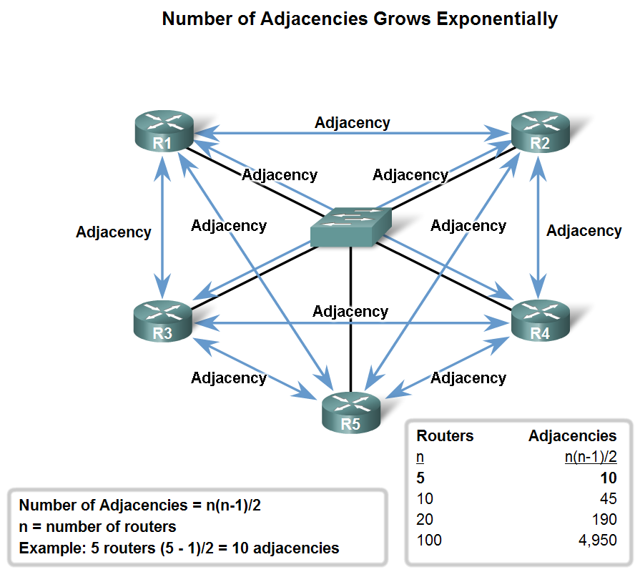
OSPF in Multiaccess Networks
2 challenges presented by multiaccess networks
  Multiple adjacencies
  Extensive LSA flooding

Slide 28
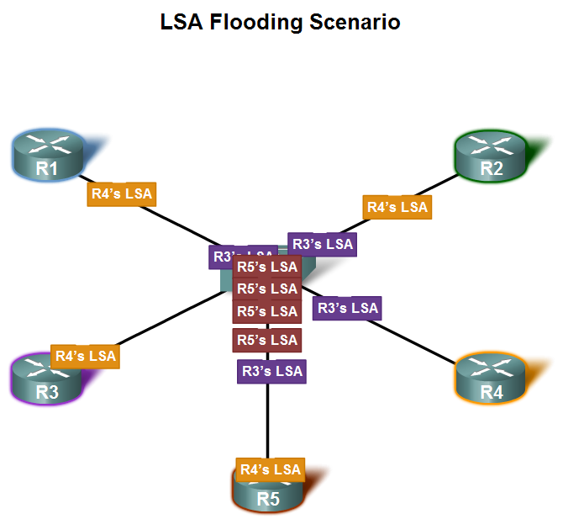
OSPF in Multiaccess Networks
Extensive flooding of LSAs
  For every LSA sent out there must be an acknowledgement of receipt sent back to transmitting router.
  consequence: lots of bandwidth consumed and chaotic traffic

Slide 29
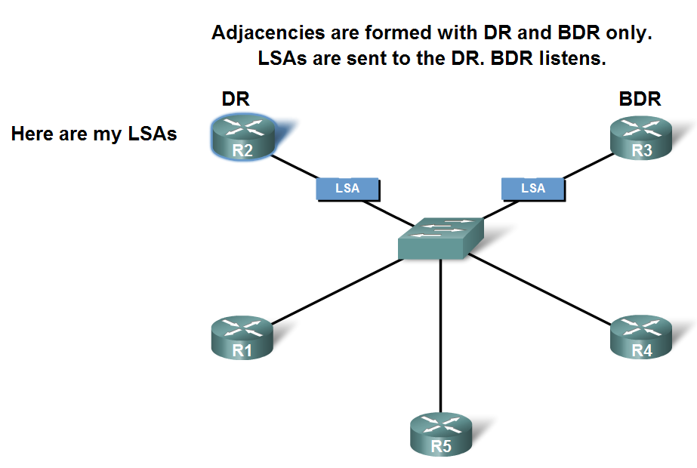
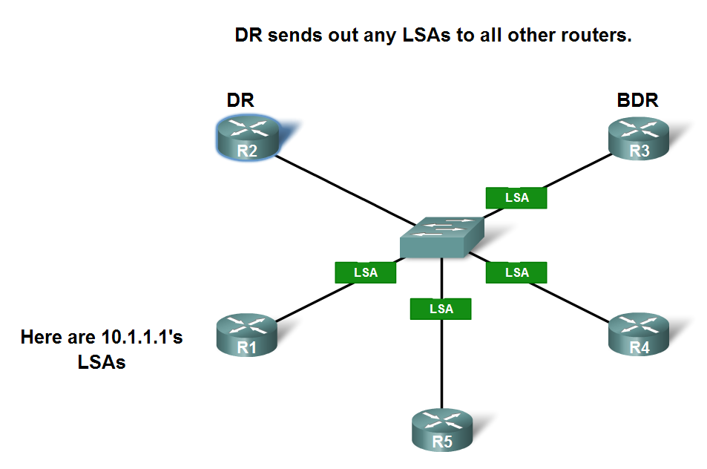
OSPF in Multiaccess Networks
Solution to LSA flooding issue is the use of
  Designated router (DR)
  Backup designated router (BDR)
  DRothers
DR & BDR selection
  Routers are elected to send & receive LSA
Sending & Receiving LSA
  DRothers send LSAs via multicast 224.0.0.6 to DR & BDR
  DR forward LSA via multicast address 224.0.0.5 to all other routers

Slide 30
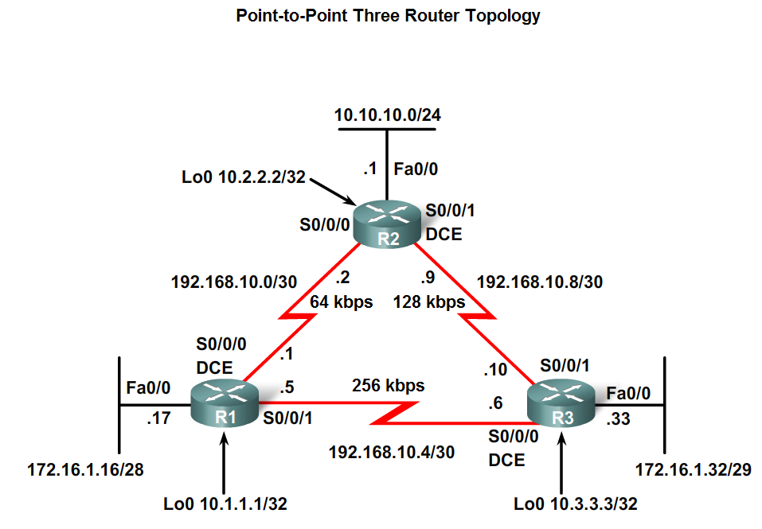
OSPF in Multiaccess Networks
DR/BDR Election Process
DR/BDR elections DO NOT occur in point to point networks

Slide 31
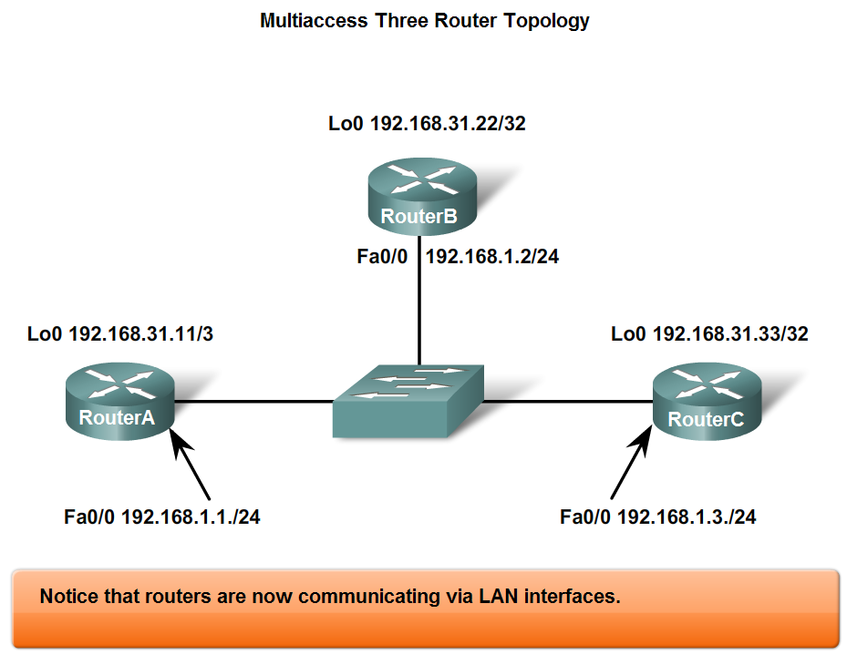
OSPF in Multiaccess Networks
DR/BDR elections will take place on multiaccess networks only as shown below

Slide 32
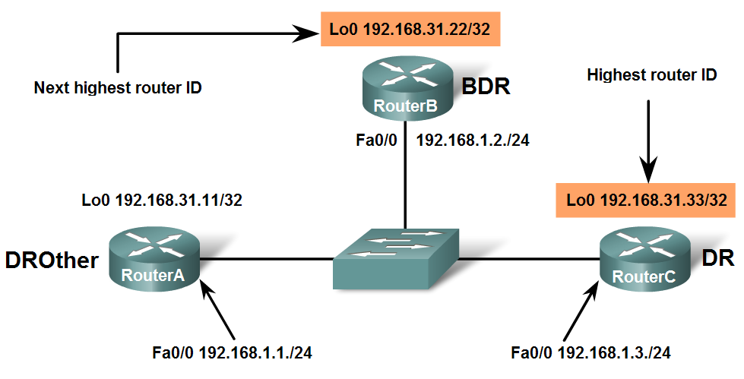
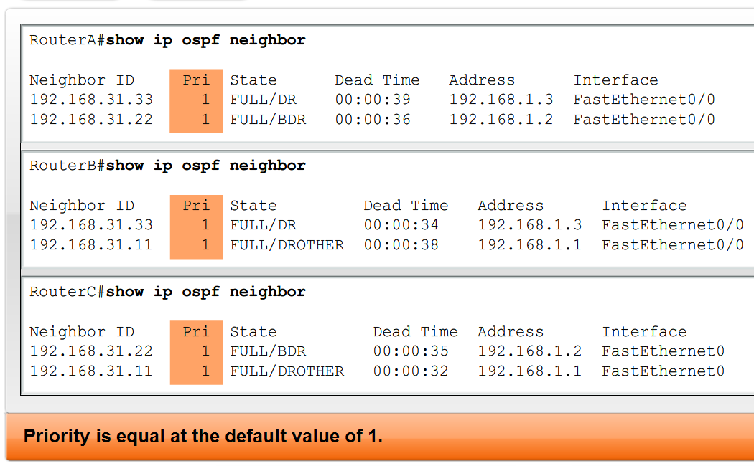
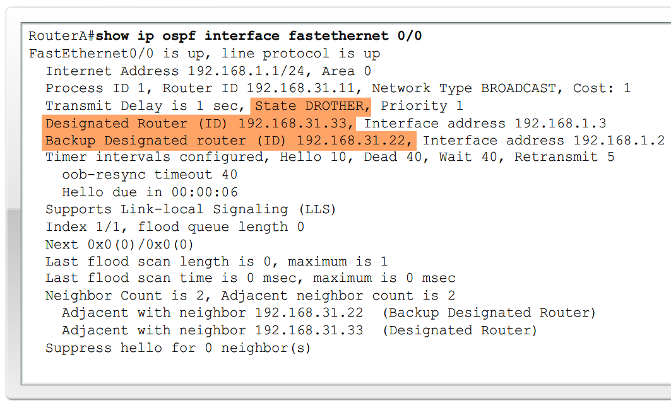
OSPF in Multiaccess Networks
Criteria for getting elected DR/BDR
  DR: Router with the highest OSPF interface priority.
  2. BDR: Router with the second highest OSPF interface priority.
  3. If OSPF interface priorities are equal, the
  highest router ID is used to break the tie.

Slide 33
OSPF in Multiaccess Networks
Timing of DR/BDR Election
  Occurs as soon as 1st router has its interface enabled on multiaccess network
    When a DR is elected it remains as the DR until one of the following occurs
      -The DR fails.
      -The OSPF process on the DR fails.
      -The multiaccess interface on the DR fails.

Slide 34
OSPF in Multiaccess Networks
Manipulating the election process
  -If you want to influence the election of DR & BDR then do one of the following
    Boot up the DR first, followed by the BDR, and then boot all other routers,
    OR
    Shut down the interface on all routers, followed by a no shutdown on the DR, then the BDR, and then all other routers.

Slide 35
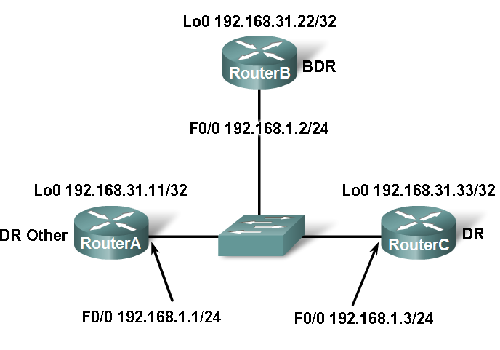
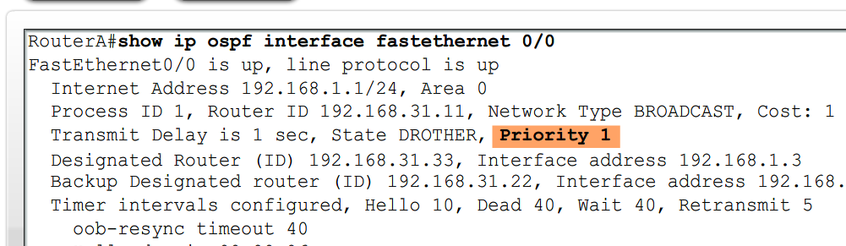
OSPF in Multiaccess Networks
OSPF Interface Priority
Manipulating the DR/BDR election process continued
  Use the ip ospf priority interface command.
  Example:Router(config-if)#ip ospf priority {0 - 255}
    Priority number range 0 to 255
      0 means the router cannot become the DR or BDR
      1 is the default priority value

Slide 36
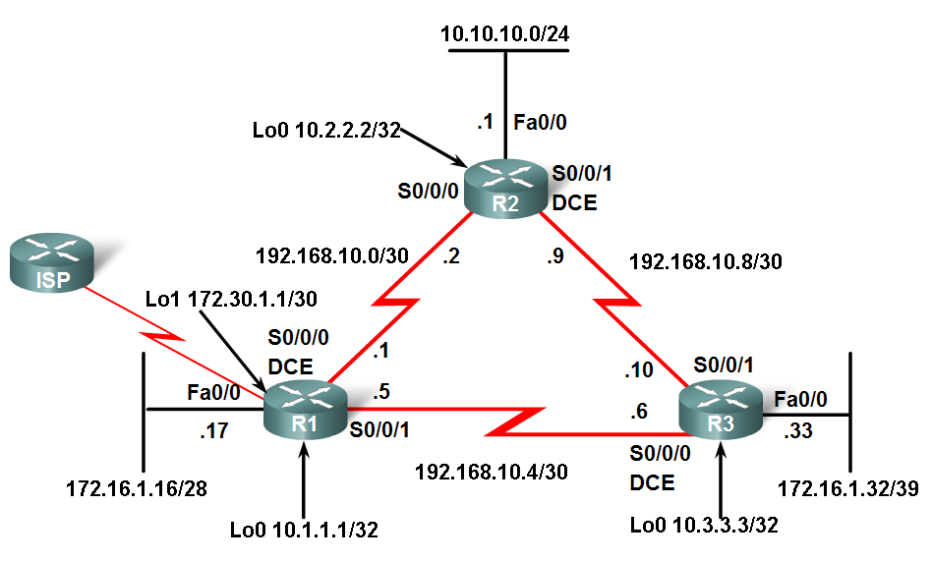
More OSPF Configuration
Redistributing an OSPF Default Route
Topology includes a link to ISP
  Router connected to ISP
    Called an autonomous system border router
    Used to propagate a default route
      Example of static default route
      R1(config)#ip route 0.0.0.0 0.0.0.0 loopback 1
      Requires the use of the default-information originate command
      Example of default-information originate command
      R1(config-router)#default-information originate

Slide 37
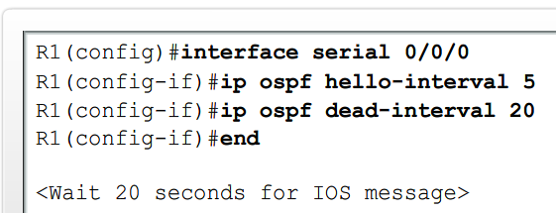
More OSPF Configuration
Fine-Tuning OSPF
Modifying OSPF timers
  Reason to modify timers
    Faster detection of network failures
  Manually modifying Hello & Dead intervals
    Router(config-if)#ip ospf hello-interval seconds
    Router(config-if)#ip ospf dead-interval seconds
  Point to be made
    Hello & Dead intervals must be the same between neighbors

